Slide 1
InStore Squad

Slide 2
Pouria Azadeh

Slide 3
Modify Search Product API
Assignee/Contributors: Pouria Azadeh
Stakeholder: Operation
Deadline: September 9
KRs: Launch of Mart in all of Smart Vendor
Accomplishments
Challenges
Start: August 31
Status: QA
Progress: OnTrack
Estimate: 2.0 Hours
Scope Chg:

Slide 4
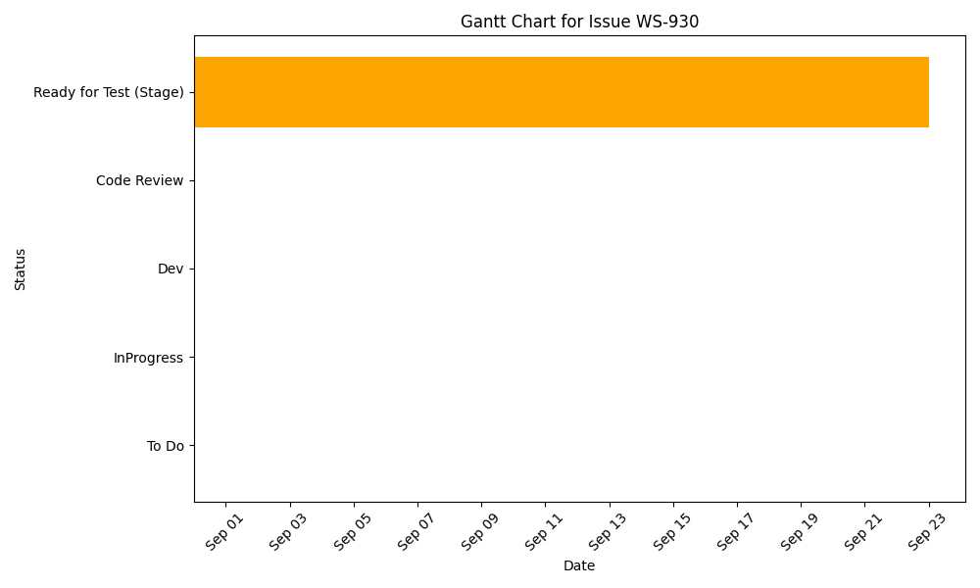

Slide 5
Fix Date Format Issue in Purchase Order Creation
Assignee/Contributors: Pouria Azadeh
Stakeholder:
Deadline:
KRs:
Accomplishments
Challenges
Start: August 31
Status: QA
Progress: OnTrack
Estimate:
Scope Chg:

Slide 6


Slide 7
Remove Limit from Classes API Response
Assignee/Contributors: Pouria Azadeh
Stakeholder: Commercial
Deadline:
KRs: Launch of Mart in all of Smart Vendor
Accomplishments
Challenges
Start: September 16
Status: QA
Progress: OnTrack
Estimate:
Scope Chg:

Slide 8
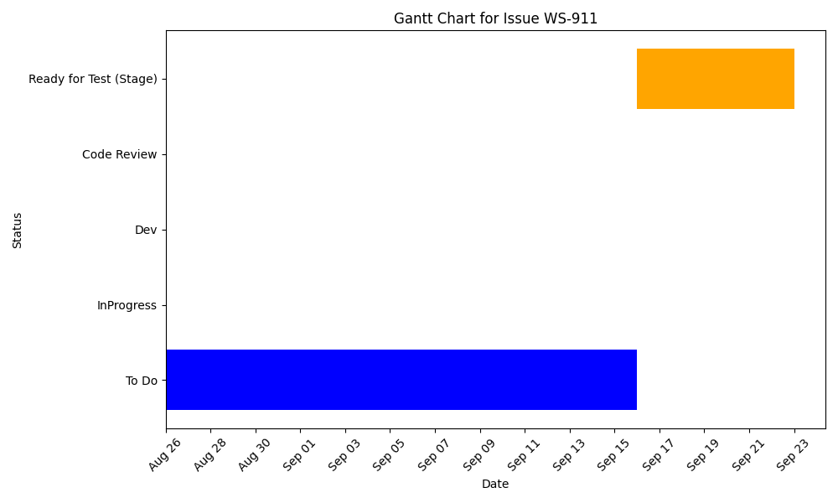

Slide 9
Suppliers' of Non-Tehran cities
Assignee/Contributors: Pouria Azadeh
Stakeholder: Commercial, Finance
Deadline:
KRs: Launch of Mart in all of Smart Vendor
Accomplishments
Challenges
Start: September 16
Status: QA
Progress: OnTrack
Estimate: 12.0 Hours
Scope Chg:

Slide 10
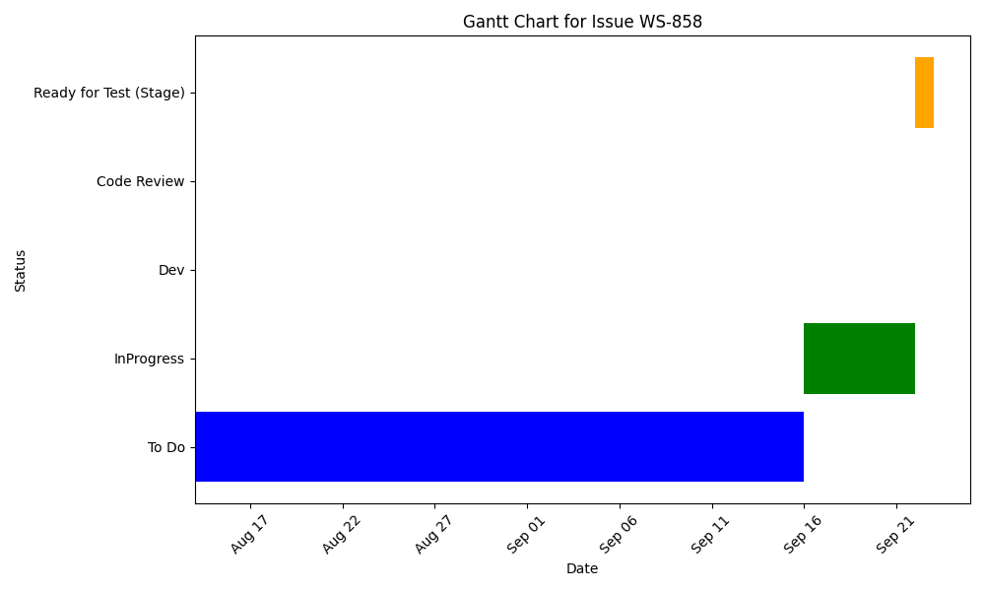

Slide 11
Real History APIs (Back)
Assignee/Contributors: Pouria Azadeh
Stakeholder: Commercial
Deadline: August 26
KRs: Launch of Mart in all of Smart Vendor
Accomplishments
Challenges
Start: August 20
Status: QA
Progress: OnTrack
Estimate: 12.0 Hours
Scope Chg:

Slide 12
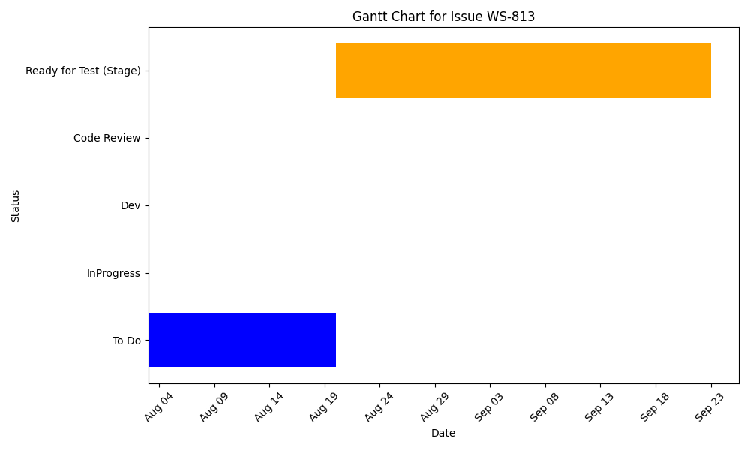

Slide 13
Fix the issue of price History
Assignee/Contributors: Pouria Azadeh
Stakeholder:
Deadline:
KRs:
Accomplishments
Challenges
Start: July 24
Status: Resolved
Progress: OnTrack
Estimate: 3.0 Hours
Scope Chg:

Slide 14
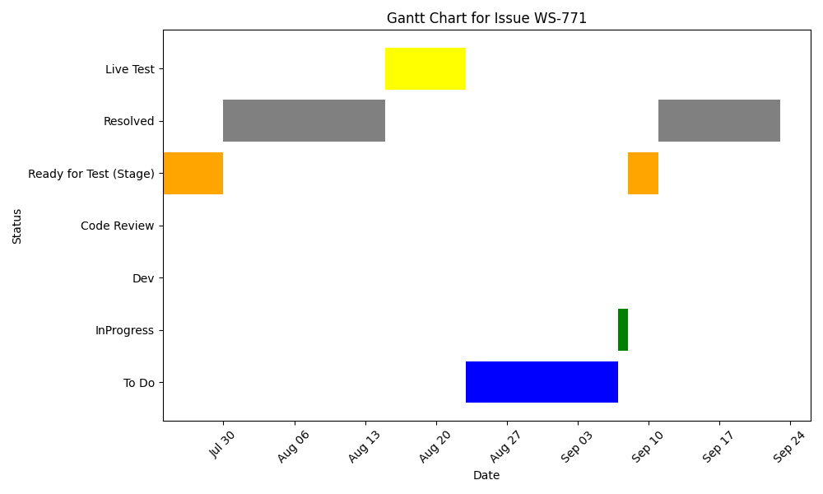

Slide 15
Finance team should be able to insert 0 as a valid number for the POs' details(Back)
Assignee/Contributors: Pouria Azadeh
Stakeholder: Finance
Deadline: August 26
KRs: Launch of Mart in all of Smart Vendor
Accomplishments
Challenges
Start: August 20
Status: Resolved
Progress: OnTrack
Estimate: 2.0 Hours
Scope Chg:

Slide 16
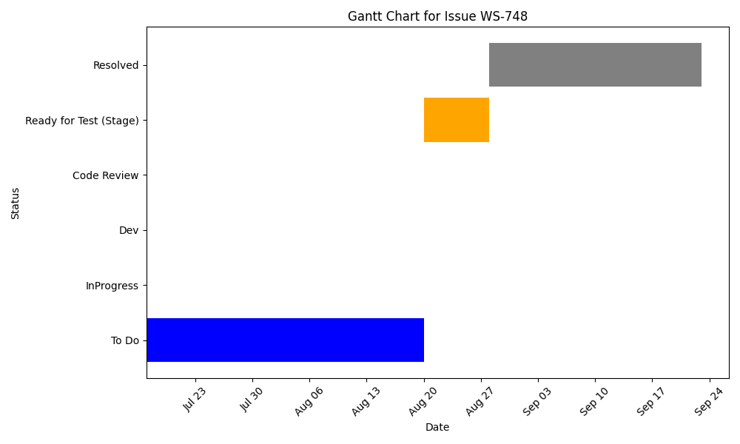

Slide 17
Transfer Request New Form(Back)
Assignee/Contributors: Pouria Azadeh
Stakeholder: Commercial
Deadline:
KRs: Launch of Mart in all of Smart Vendor
Accomplishments
Challenges
Start: August 5
Status: QA
Progress: OnTrack
Estimate: 18.0 Hours
Scope Chg:

Slide 18
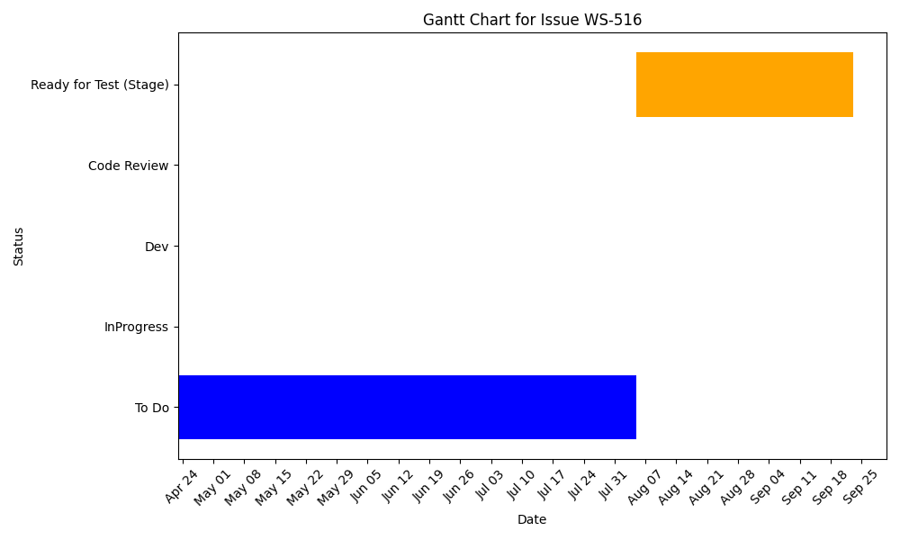

Slide 19
Purchase Order New Form(Back)
Assignee/Contributors: Pouria Azadeh
Stakeholder:
Deadline:
KRs:
Accomplishments
Challenges
Start: July 23
Status: QA
Progress: OnTrack
Estimate: 18.0 Hours
Scope Chg:

Slide 20
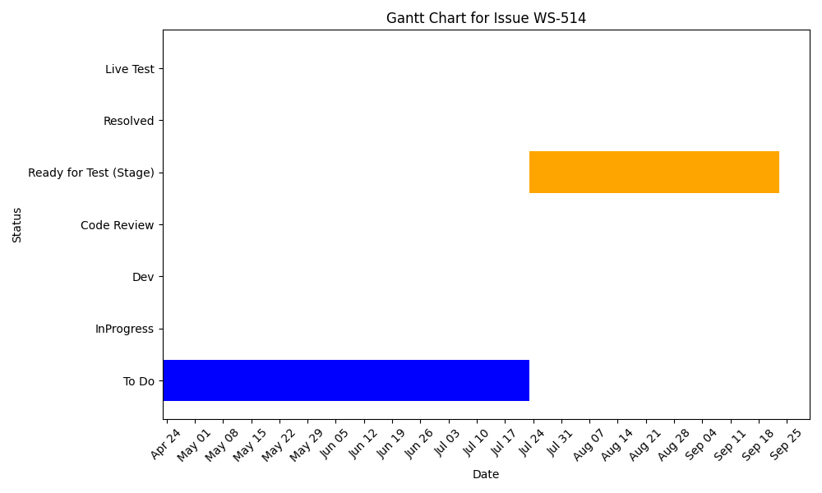

Slide 21
Ali Mokhtari

Slide 22
Automate Financial Job Execution
Assignee/Contributors: Ali Mokhtari
Stakeholder: Finance
Deadline:
KRs:
Accomplishments
Challenges
Start: September 16
Status: InProgress
Progress: OnTrack
Estimate: 6.0 Hours
Scope Chg:

Slide 23
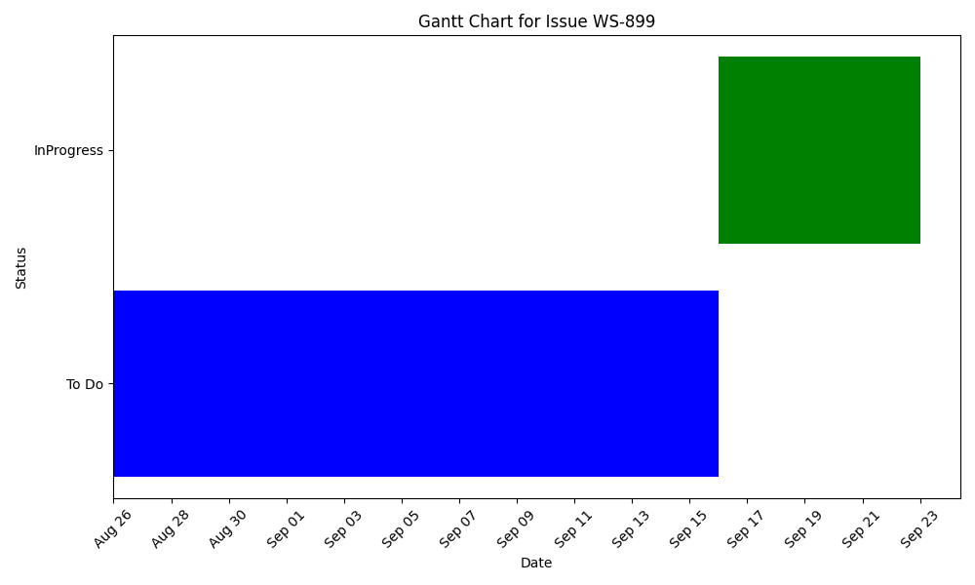

Slide 24
fix warehouse http logger middleware
Assignee/Contributors: Ali Mokhtari
Stakeholder:
Deadline:
KRs:
Accomplishments
Challenges
Start: August 20
Status: Resolved
Progress: OnTrack
Estimate:
Scope Chg:

Slide 25
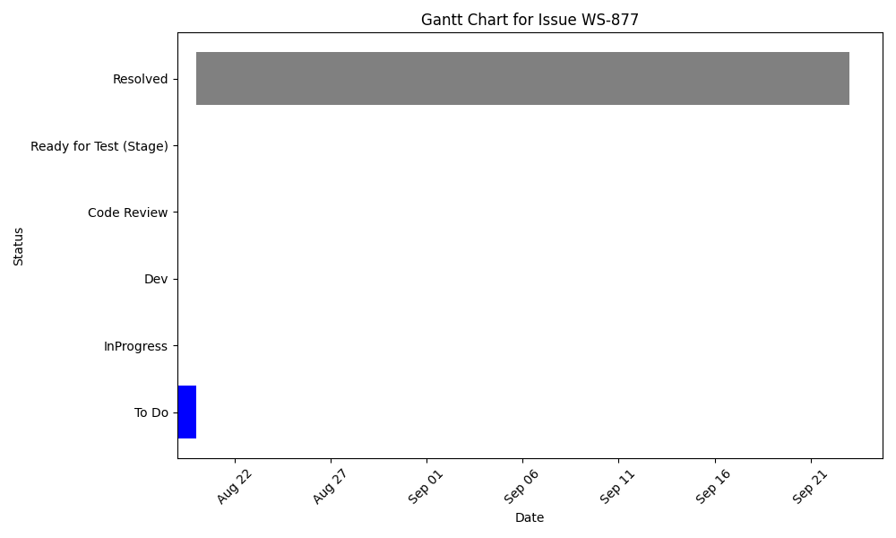

Slide 26
Real time connection (Mart Panel- Back)
Assignee/Contributors: Ali Mokhtari
Stakeholder: Operation, Tech
Deadline: September 22
KRs: Realtime Features
Accomplishments
Challenges
Start: August 20
Status: InProgress
Progress: OnTrack
Estimate: 12.0 Hours
Scope Chg:

Slide 27
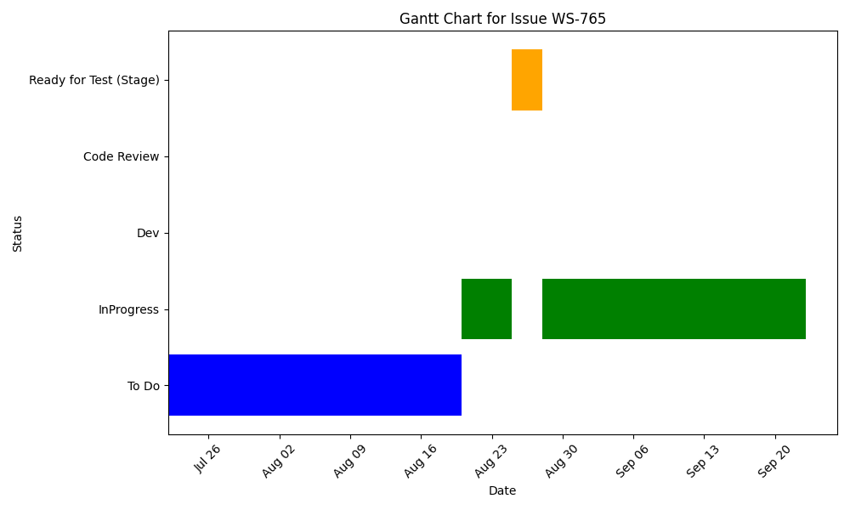

Slide 28
Group report on the Financial orders list(Back)
Assignee/Contributors: Ali Mokhtari
Stakeholder: Finance
Deadline:
KRs: Launch of Mart in all of Smart Vendor
Accomplishments
Challenges
Start: August 6
Status: Resolved
Progress: OnTrack
Estimate: 3.0 Hours
Scope Chg:

Slide 29
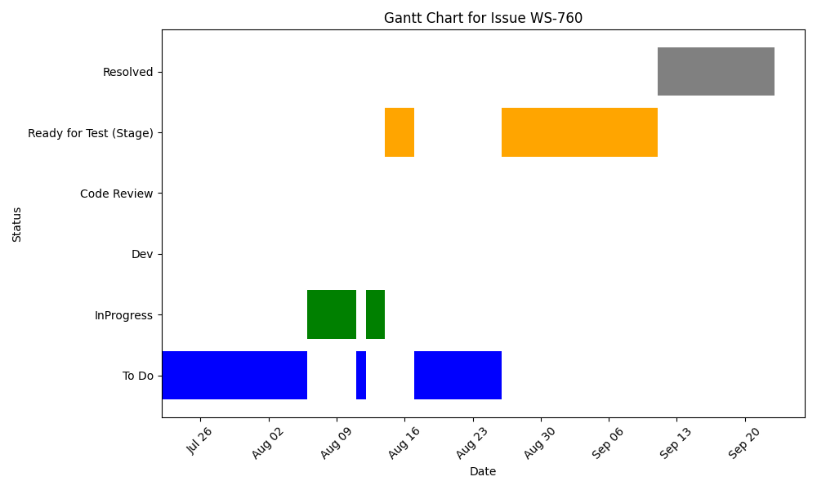

Slide 30
Export Detailed Financial Report(Back)
Assignee/Contributors: Ali Mokhtari
Stakeholder:
Deadline:
KRs:
Accomplishments
Challenges
Start: July 28
Status: QA
Progress: OnTrack
Estimate: 12.0 Hours
Scope Chg:

Slide 31
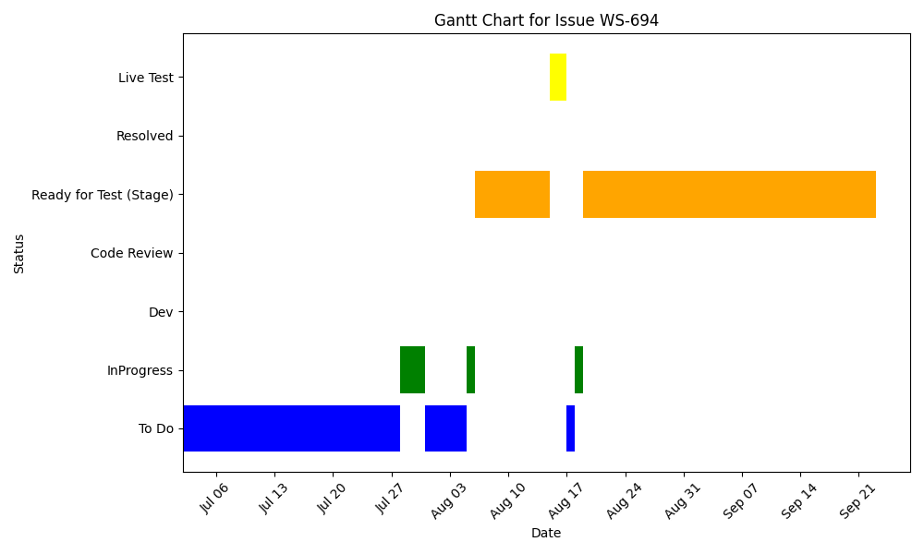

Slide 32
Amir Mohsen Jalili

Slide 33
Fix the Error Display Issues in the Panel
Assignee/Contributors: Amir Mohsen Jalili
Stakeholder:
Deadline:
KRs:
Accomplishments
Challenges
Start: September 22
Status: InProgress
Progress: OnTrack
Estimate: 6.0 Hours
Scope Chg:

Slide 34
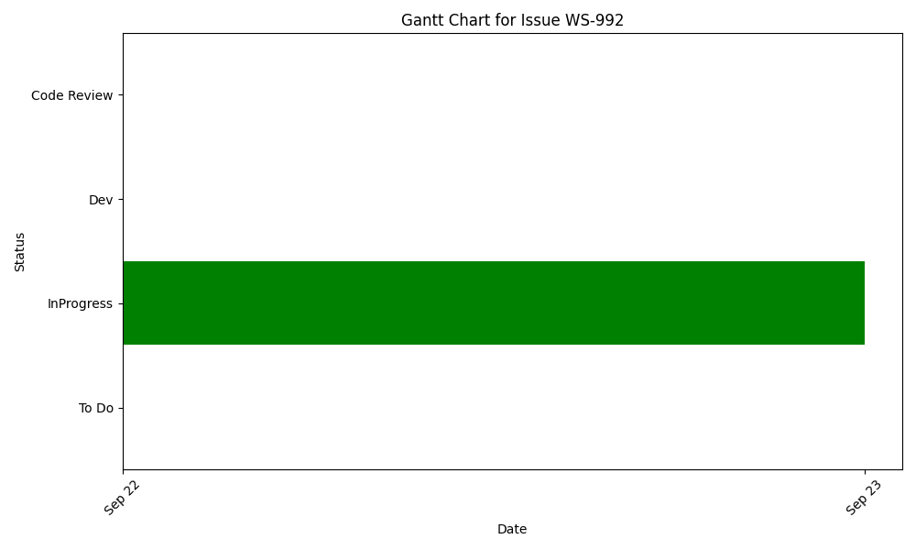

Slide 35
Add New Columns to Product History Page
Assignee/Contributors: Amir Mohsen Jalili
Stakeholder: Commercial
Deadline: September 22
KRs: Launch of Mart in all of Smart Vendor
Accomplishments
Challenges
Start: September 18
Status: QA
Progress: OnTrack
Estimate: 2.0 Hours
Scope Chg:

Slide 36
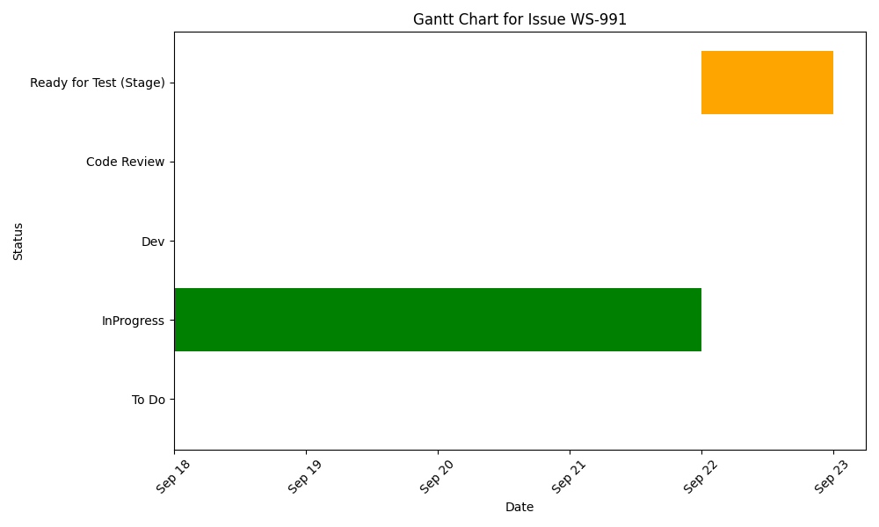

Slide 37
Fix the issue of Export Price Discrepancies Details
Assignee/Contributors: Amir Mohsen Jalili
Stakeholder:
Deadline:
KRs:
Accomplishments
Challenges
Start: September 17
Status: QA
Progress: OnTrack
Estimate: 3.0 Hours
Scope Chg:

Slide 38
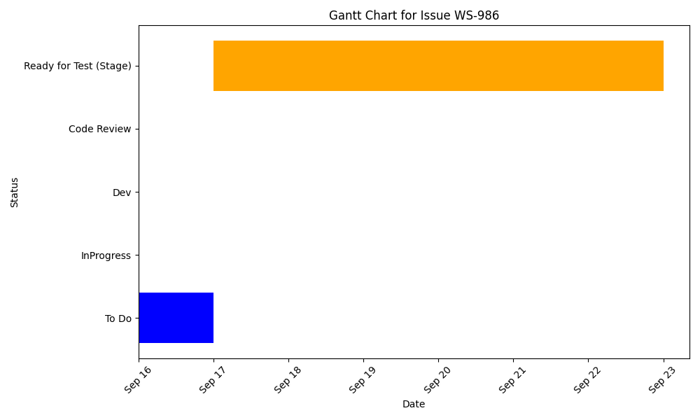

Slide 39
Add Filter to Products History(front)
Assignee/Contributors: Amir Mohsen Jalili
Stakeholder: Commercial
Deadline:
KRs: Launch of Mart in all of Smart Vendor
Accomplishments
Challenges
Start: September 1
Status: QA
Progress: OnTrack
Estimate: 1.0 Hours
Scope Chg:

Slide 40
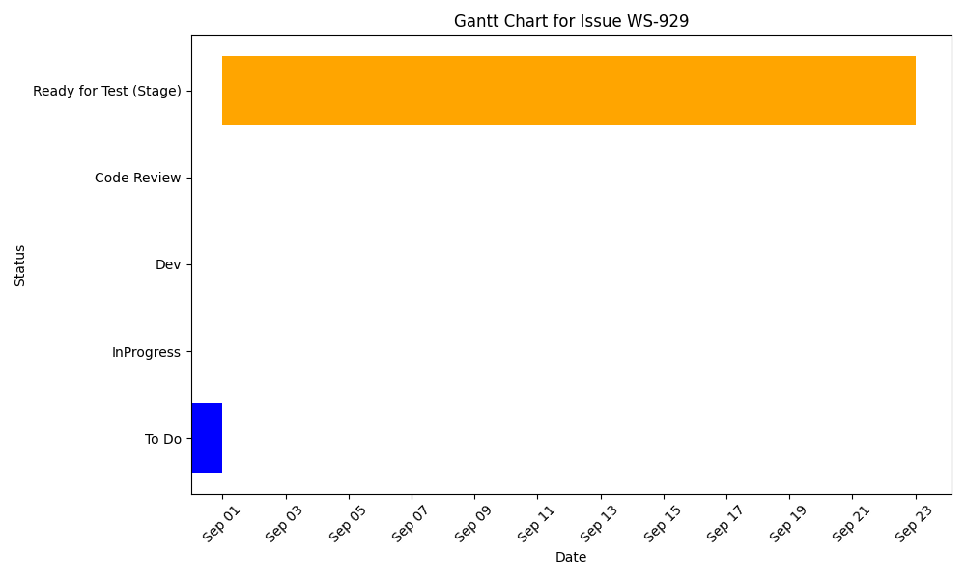

Slide 41
Implement Bulk Discount on Purchase Order&Discrepancy&Financial Details (front)
Assignee/Contributors: Amir Mohsen Jalili
Stakeholder:
Deadline:
KRs:
Accomplishments
Challenges
Start: September 7
Status: Resolved
Progress: OnTrack
Estimate: 6.0 Hours
Scope Chg:

Slide 42
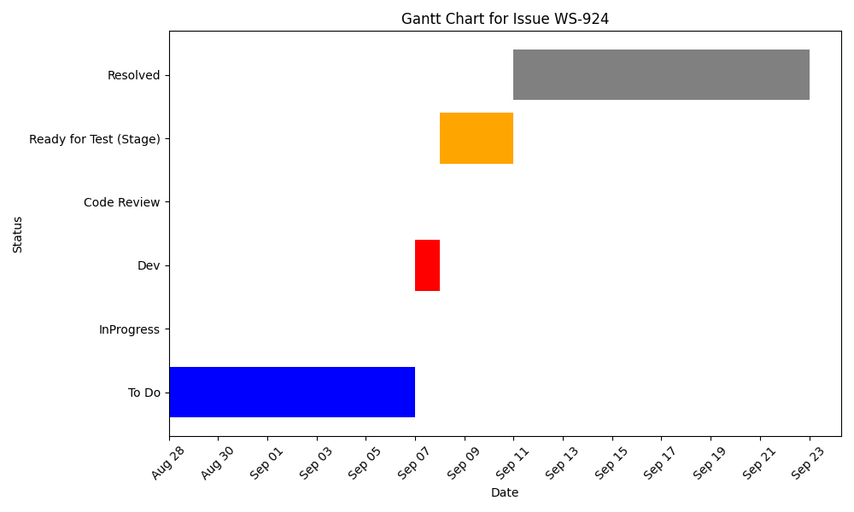

Slide 43
Add and Edit Tax Column in Purchase Order Details & Update Total Calculation(Front)
Assignee/Contributors: Amir Mohsen Jalili
Stakeholder:
Deadline:
KRs:
Accomplishments
Challenges
Start: September 17
Status: QA
Progress: OnTrack
Estimate: 3.0 Hours
Scope Chg:

Slide 44
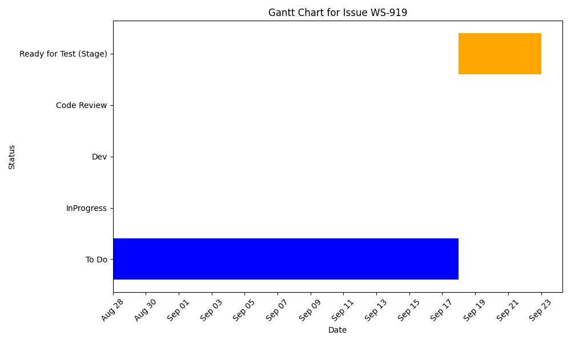

Slide 45
Convert Panel URLs to Kebab-Case
Assignee/Contributors: Amir Mohsen Jalili
Stakeholder: Tech
Deadline: September 19
KRs: Launch of Mart in all of Smart Vendor
Accomplishments
Challenges
Replace PacalCase to kebab-case
Start: September 3
Status: QA
Progress: OnTrack
Estimate: 4.0 Hours
Scope Chg:

Slide 46
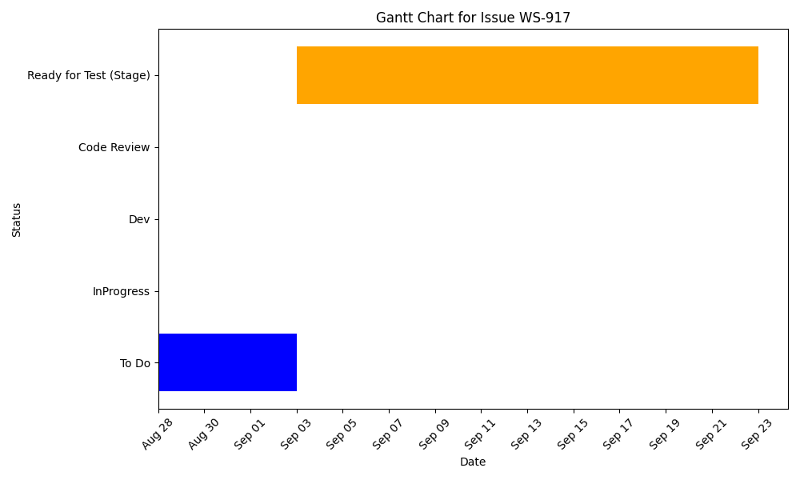

Slide 47
Fix the issue of Display Error Message in Aisles File Import
Assignee/Contributors: Amir Mohsen Jalili
Stakeholder:
Deadline:
KRs:
Accomplishments
Challenges
Start: August 28
Status: Dev
Progress: OnTrack
Estimate: 1.0 Hours
Scope Chg:

Slide 48
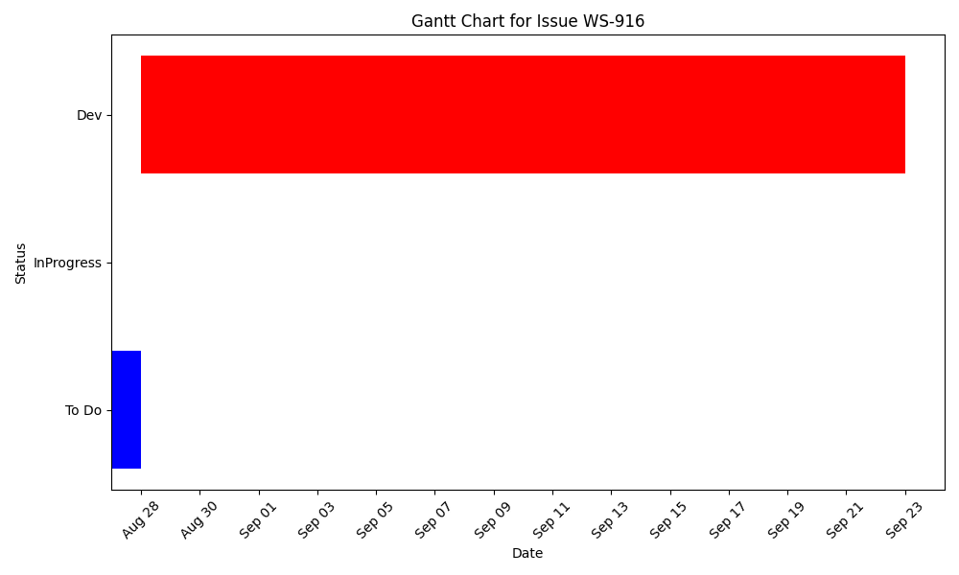

Slide 49
Add a separate access for the PO/TRs' export
Assignee/Contributors: Amir Mohsen Jalili
Stakeholder: Finance
Deadline:
KRs: Launch of Mart in all of Smart Vendor
Accomplishments
Challenges
edit and fix permission for roles in purchase order list
Start: August 24
Status: QA
Progress: OnTrack
Estimate: 1.0 Hours
Scope Chg:

Slide 50


Slide 51
Add validations of PO's Confirmation
Assignee/Contributors: Amir Mohsen Jalili
Stakeholder: Commercial
Deadline: September 9
KRs: Launch of Mart in all of Smart Vendor
Accomplishments
Challenges
fixed rate for enter percent
added validation to percent value in editable cells
Start: August 20
Status: Resolved
Progress: OnTrack
Estimate: 4.0 Hours
Scope Chg:

Slide 52
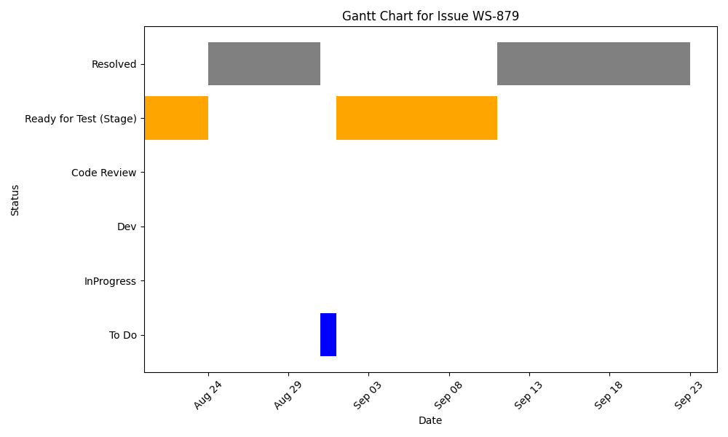

Slide 53
Fix the Issue of Reverse Display of Discount Decimals
Assignee/Contributors: Amir Mohsen Jalili
Stakeholder:
Deadline:
KRs:
Accomplishments
Challenges
Start: August 20
Status: Resolved
Progress: OnTrack
Estimate: 2.0 Hours
Scope Chg:

Slide 54
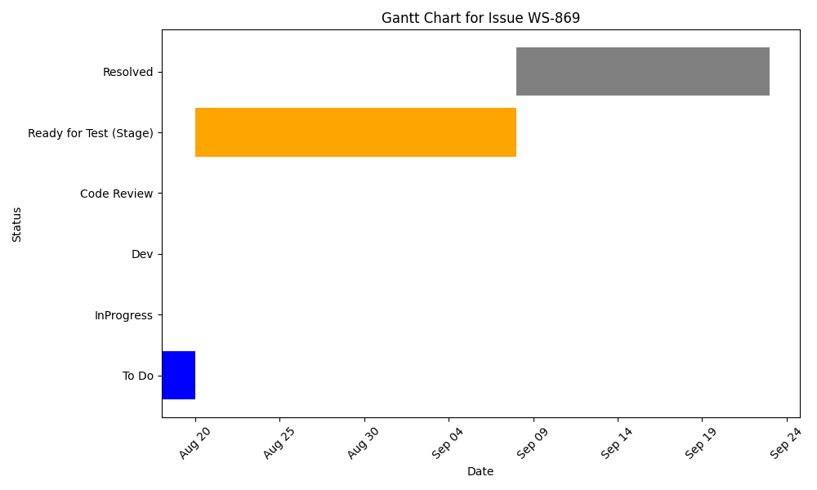

Slide 55
Fix Discount Amount Display Issue on Product Management
Assignee/Contributors: Amir Mohsen Jalili
Stakeholder:
Deadline:
KRs:
Accomplishments
Challenges
Start: August 6
Status: Resolved
Progress: OnTrack
Estimate: 1.0 Hours
Scope Chg:

Slide 56
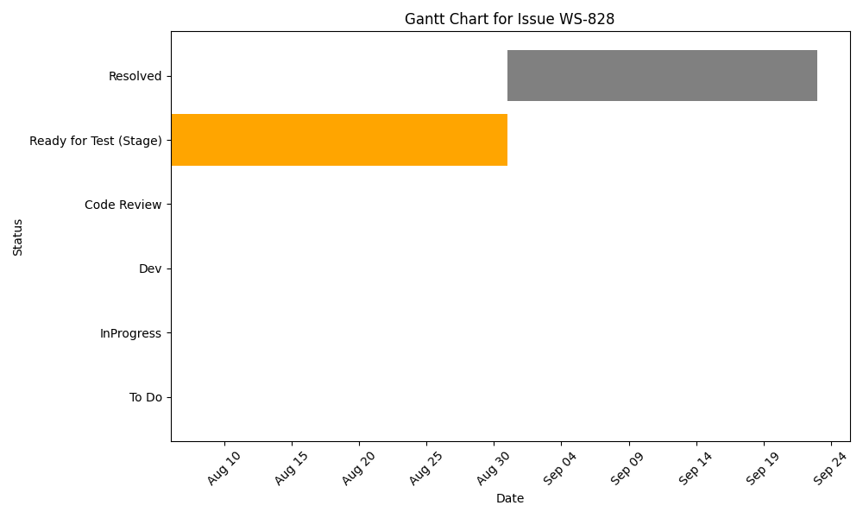

Slide 57
Bulk confirm of POs & TRs (Front)
Assignee/Contributors: Amir Mohsen Jalili
Stakeholder: Commercial
Deadline: September 9
KRs: Launch of Mart in all of Smart Vendor
Accomplishments
Challenges
Easier to confirm orders
add check box for confirm init status_x000D_
Start: August 21
Status: Resolved
Progress: OnTrack
Estimate: 12.0 Hours
Scope Chg:

Slide 58
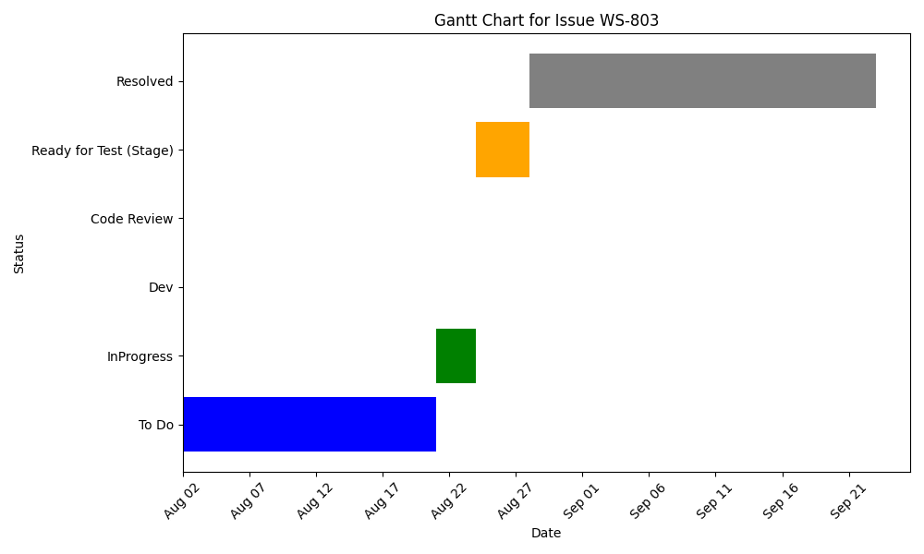

Slide 59
Adding Pagination to Price History Page
Assignee/Contributors: Amir Mohsen Jalili
Stakeholder: Commercial
Deadline: September 16
KRs: Launch of Mart in all of Smart Vendor
Accomplishments
Challenges
Add new API for price history
Start: July 24
Status: Resolved
Progress: OnTrack
Estimate: 2.0 Hours
Scope Chg:

Slide 60
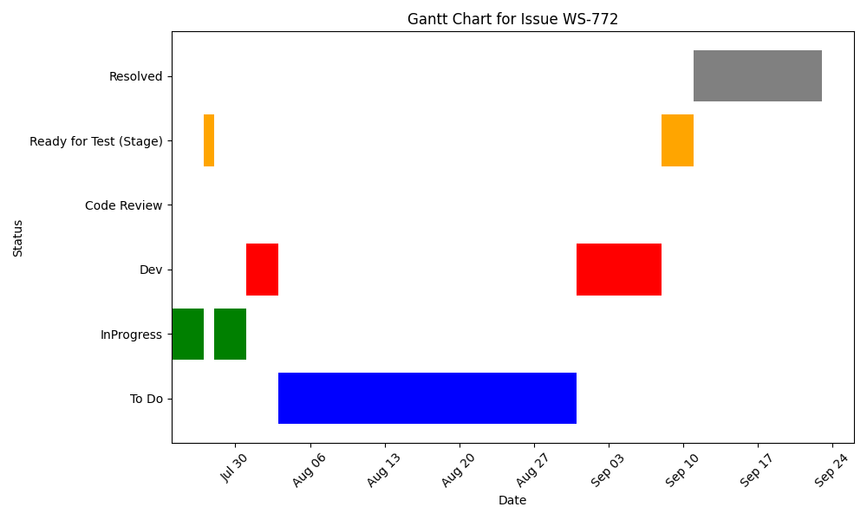

Slide 61
Transfer Request New Form(Front)
Assignee/Contributors: Amir Mohsen Jalili
Stakeholder: Commercial
Deadline: September 2
KRs: Launch of Mart in all of Smart Vendor
Accomplishments
Challenges
Avoiding errors of adding transfer request through Excel file
add new page and forms in the page for create new transfer request
Start: August 24
Status: QA
Progress: OnTrack
Estimate: 12.0 Hours
Scope Chg:

Slide 62
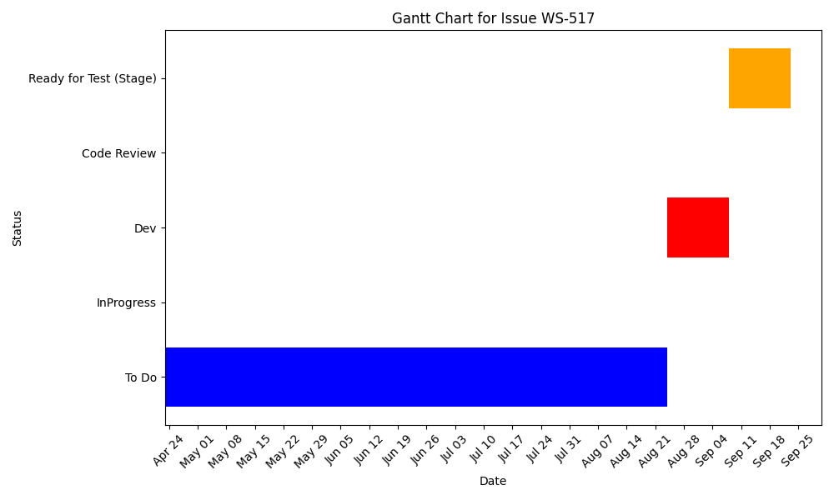

Slide 63
Purchase Order New Form(Front)
Assignee/Contributors: Amir Mohsen Jalili
Stakeholder: Commercial
Deadline: September 1
KRs: Launch of Mart in all of Smart Vendor
Accomplishments
Challenges
Avoiding errors of adding new purchase order through Excel file
add new page and forms in the page for create new purchase order
Start: July 24
Status: QA
Progress: OnTrack
Estimate: 18.0 Hours
Scope Chg:

Slide 64
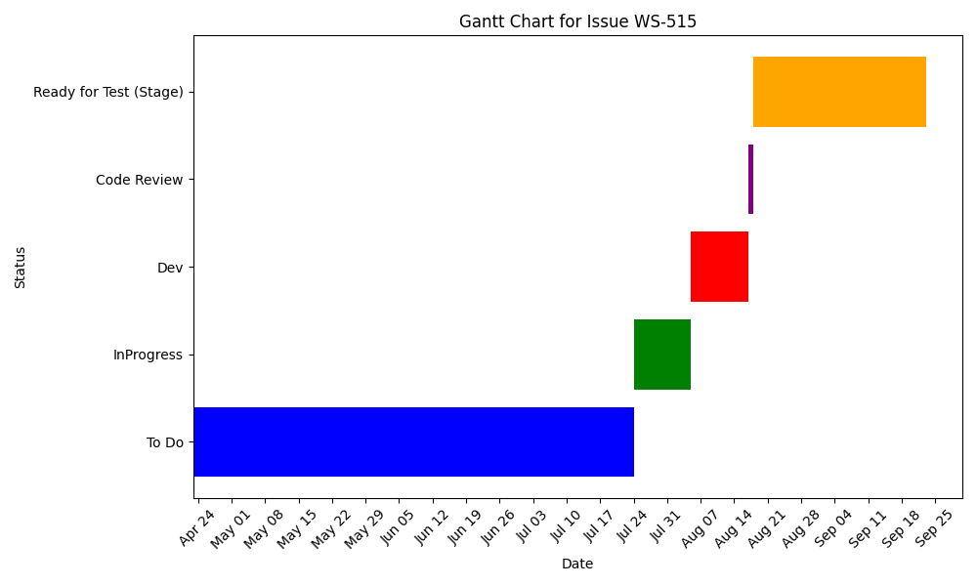

Slide 65
Farnoosh Rad

Slide 66
Fix Display Issue in Invoice for Large Orders
Assignee/Contributors: Farnoosh Rad
Stakeholder:
Deadline:
KRs:
Accomplishments
Challenges
Start: September 9
Status: InProgress
Progress: OnTrack
Estimate: 5.0 Hours
Scope Chg:

Slide 67
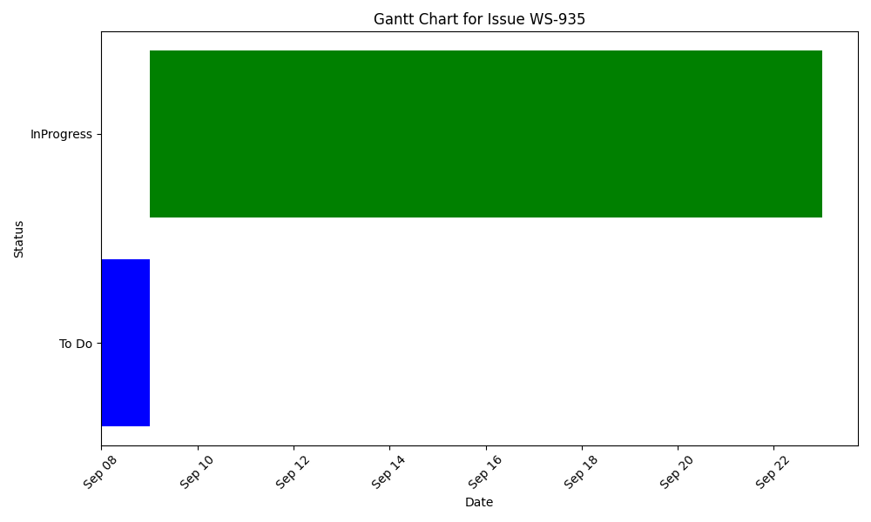

Slide 68
Access per vendor(front)
Assignee/Contributors: Farnoosh Rad
Stakeholder: Operation
Deadline:
KRs: Launch of Mart in all of Smart Vendor
Accomplishments
Challenges
Start: September 8
Status: QA
Progress: OnTrack
Estimate: 2.0 Hours
Scope Chg:

Slide 69
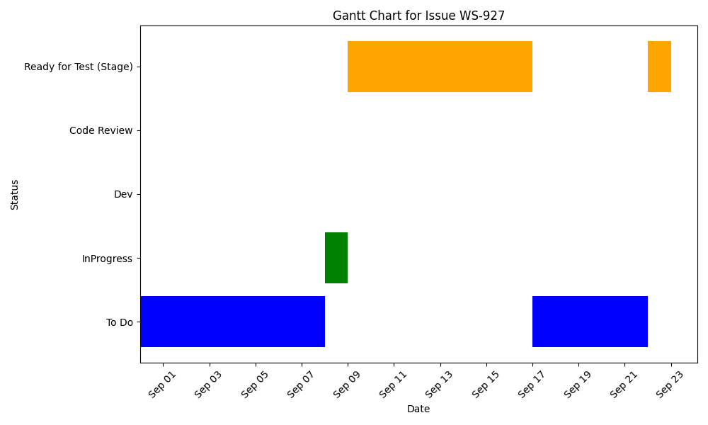

Slide 70
Enable Purchase Order Invoice in a New Tab(Front)
Assignee/Contributors: Farnoosh Rad
Stakeholder: Finance
Deadline:
KRs: Launch of Mart in all of Smart Vendor
Accomplishments
Challenges
Start: September 22
Status: InProgress
Progress: OnTrack
Estimate: 0.5 Hours
Scope Chg:

Slide 71
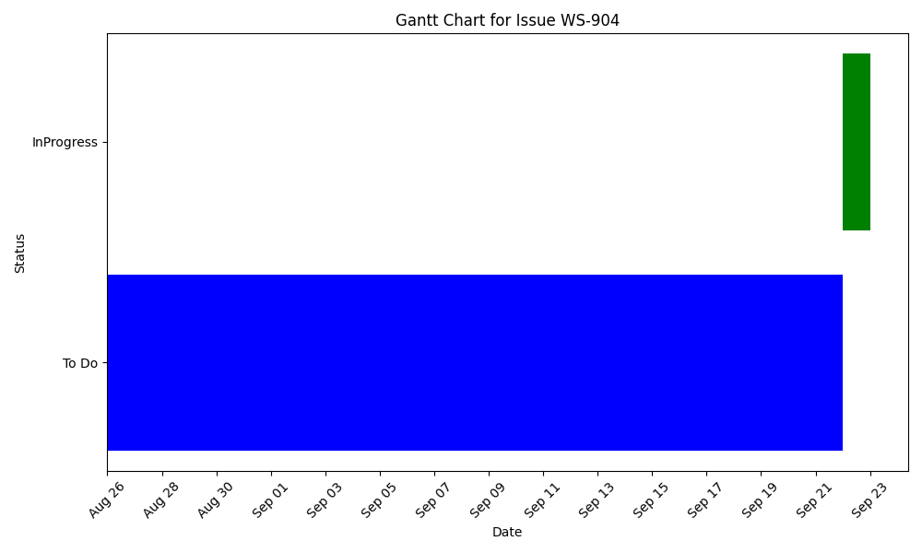

Slide 72
fix pending picklists request for statistics request
Assignee/Contributors: Farnoosh Rad
Stakeholder: Operation, Tech
Deadline:
KRs: Launch of Mart in all of Smart Vendor
Accomplishments
Challenges
Start: August 17
Status: Resolved
Progress: OnTrack
Estimate: 3.0 Hours
Scope Chg:

Slide 73
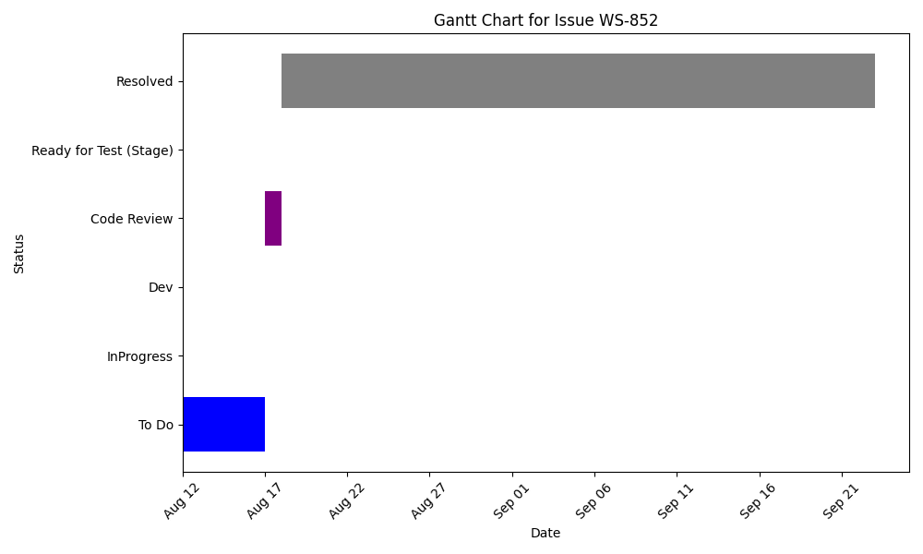

Slide 74
Export Product Inventory Details (Front)
Assignee/Contributors: Farnoosh Rad
Stakeholder:
Deadline:
KRs:
Accomplishments
Challenges
Start: September 22
Status: Code Review
Progress: OnTrack
Estimate: 3.0 Hours
Scope Chg:

Slide 75
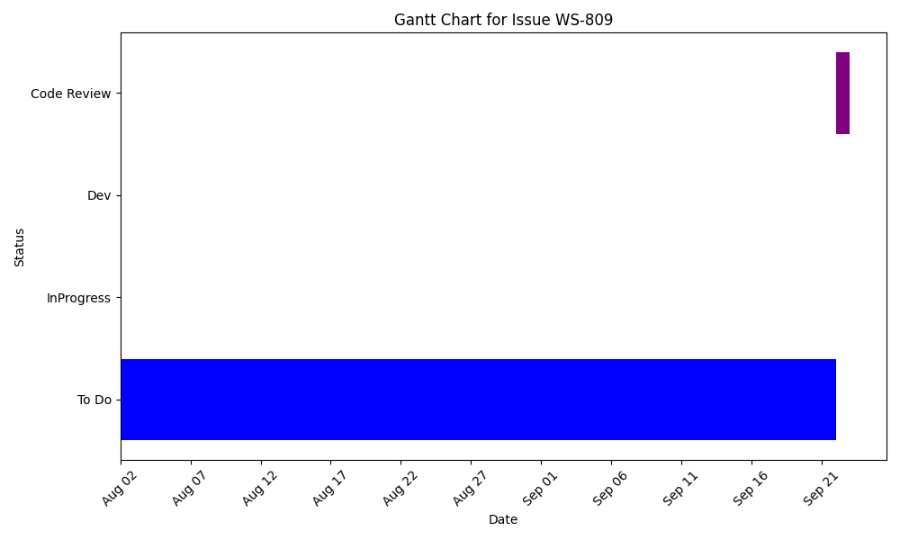

Slide 76
Mahnaz Shabihi

Slide 77
Display the QC Reason's List(Back)
Assignee/Contributors: Mahnaz Shabihi
Stakeholder:
Deadline:
KRs:
Accomplishments
Challenges
Start: September 16
Status: QA
Progress: OnTrack
Estimate: 6.0 Hours
Scope Chg:

Slide 78
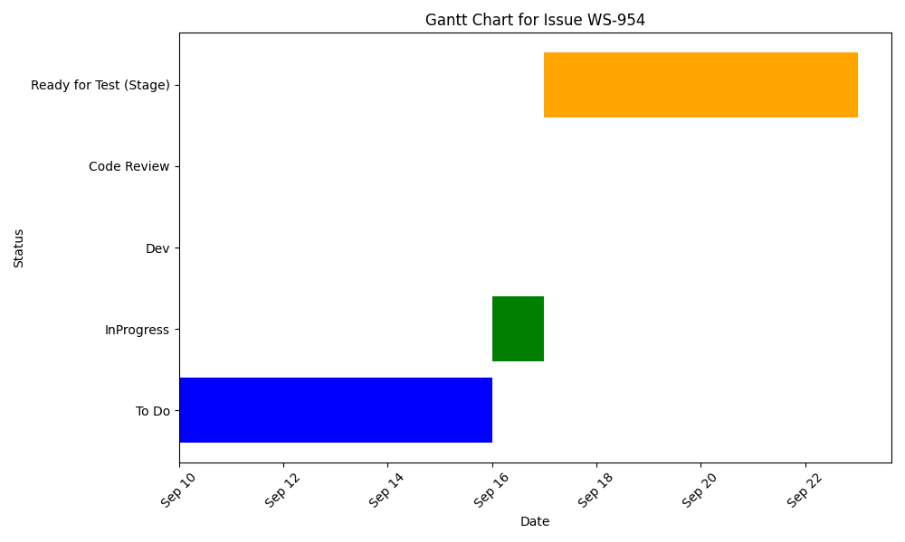

Slide 79
Add POs/Trs ID to Inventory Log
Assignee/Contributors: Mahnaz Shabihi
Stakeholder: Operation
Deadline: September 22
KRs: Launch of Mart in all of Smart Vendor
Accomplishments
Challenges
Add Po Id and Tr Id to Log_x000D_ Add Reference Type to Log
Start: September 22
Status: QA
Progress: OnTrack
Estimate: 6.0 Hours
Scope Chg:

Slide 80
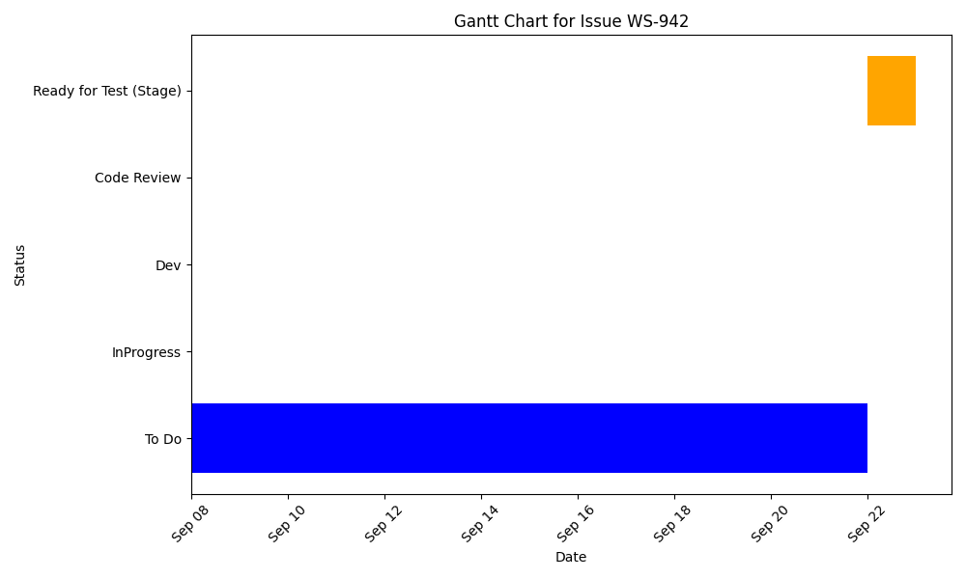

Slide 81
Add purchase_promotion_price and MRP_promotion_price Fields to Product Supplier
Assignee/Contributors: Mahnaz Shabihi
Stakeholder: Commercial
Deadline: August 31
KRs: Launch of Mart in all of Smart Vendor
Accomplishments
Challenges
Start: September 1
Status: Resolved
Progress: OnTrack
Estimate: 4.0 Hours
Scope Chg:

Slide 82
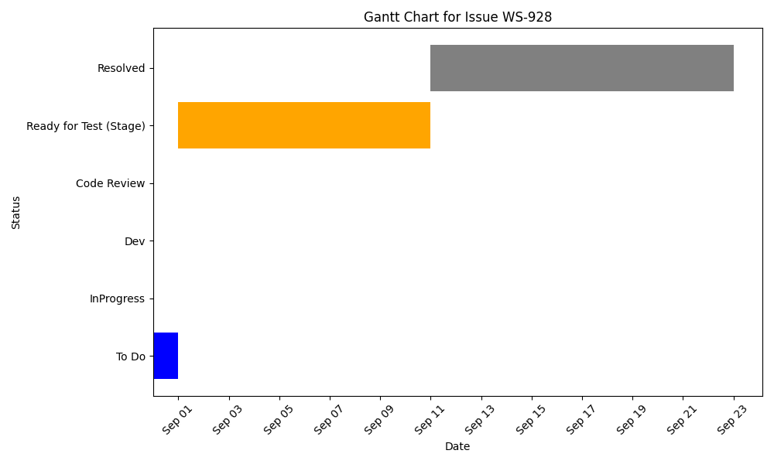

Slide 83
Add and Edit Tax Column in Purchase Order Details (Back)
Assignee/Contributors: Mahnaz Shabihi
Stakeholder:
Deadline:
KRs:
Accomplishments
Challenges
Start: September 7
Status: QA
Progress: OnTrack
Estimate: 1.0 Hours
Scope Chg:

Slide 84
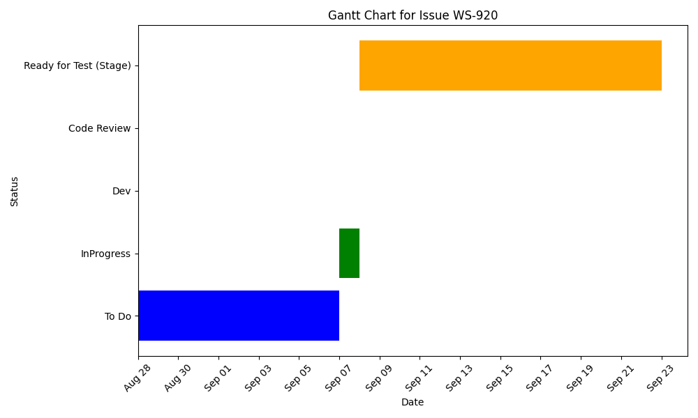

Slide 85
Validate Promotion Purchase Price During Order Placement
Assignee/Contributors: Mahnaz Shabihi
Stakeholder: Commercial
Deadline:
KRs: Launch of Mart in all of Smart Vendor
Accomplishments
Challenges
Start: September 1
Status: Resolved
Progress: OnTrack
Estimate: 2.0 Hours
Scope Chg:

Slide 86
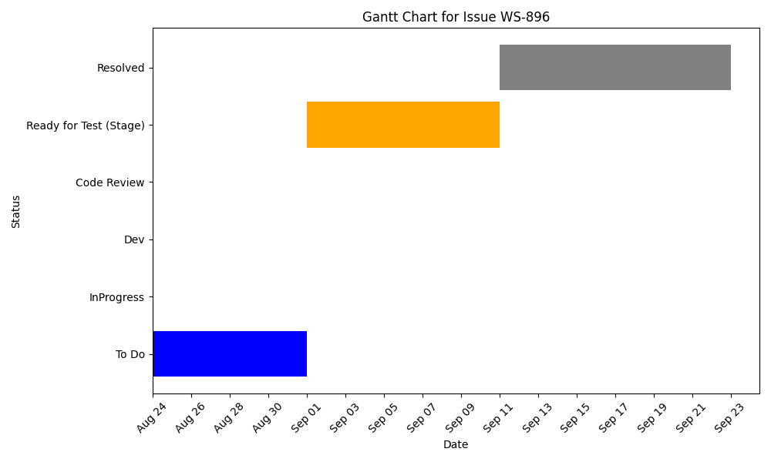

Slide 87
Add Vendor Access to All APIs
Assignee/Contributors: Mahnaz Shabihi
Stakeholder: Operation
Deadline: August 24
KRs: Launch of Mart in all of Smart Vendor
Accomplishments
Challenges
Add agent constraints to authorize api response_x000D_ Add assign api for access vendor
Start: August 21
Status: QA
Progress: OnTrack
Estimate:
Scope Chg:

Slide 88
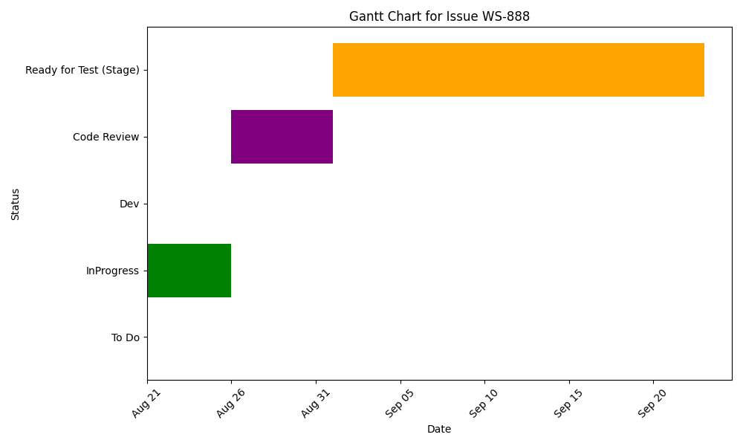

Slide 89
Remove gorm.DB.Model from warehosue repository
Assignee/Contributors: Mahnaz Shabihi
Stakeholder: Tech
Deadline:
KRs: Launch of Mart in all of Smart Vendor
Accomplishments
Challenges
Start: September 1
Status: InProgress
Progress: OnTrack
Estimate: 4.0 Hours
Scope Chg:

Slide 90
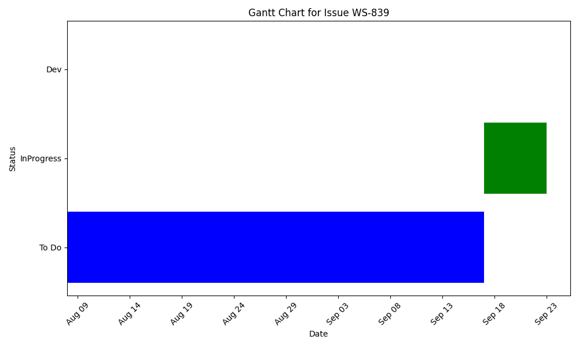

Slide 91
Export Product Inventory Details (Back)
Assignee/Contributors: Mahnaz Shabihi
Stakeholder: Commercial
Deadline: September 14
KRs: Launch of Mart in all of Smart Vendor
Accomplishments
Challenges
Start: September 1
Status: QA
Progress: OnTrack
Estimate: 5.0 Hours
Scope Chg:

Slide 92
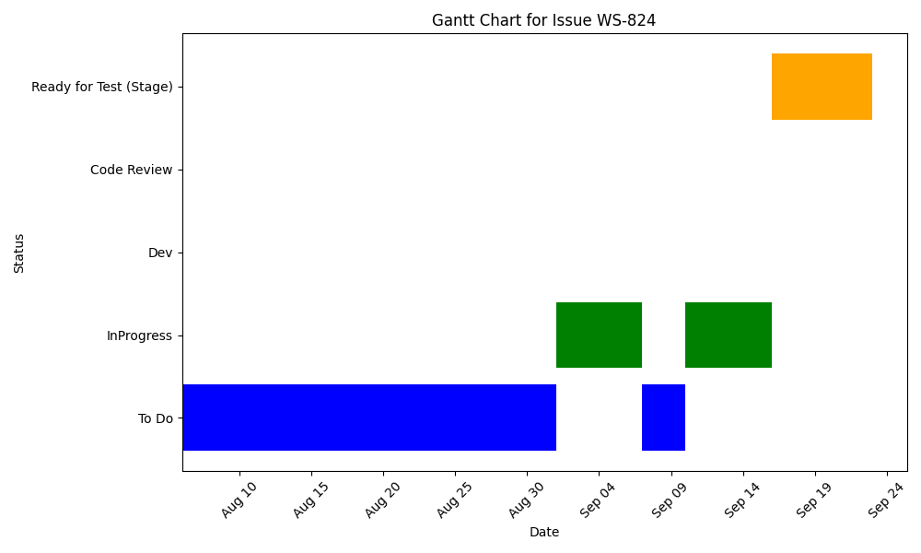

Slide 93
Export Price Discrepancies Details (Back)
Assignee/Contributors: Mahnaz Shabihi
Stakeholder: Commercial
Deadline: August 14
KRs: Launch of Mart in all of Smart Vendor
Accomplishments
Challenges
Export sale and purchase price discrepancy
Start: August 12
Status: QA
Progress: OnTrack
Estimate: 12.0 Hours
Scope Chg:

Slide 94
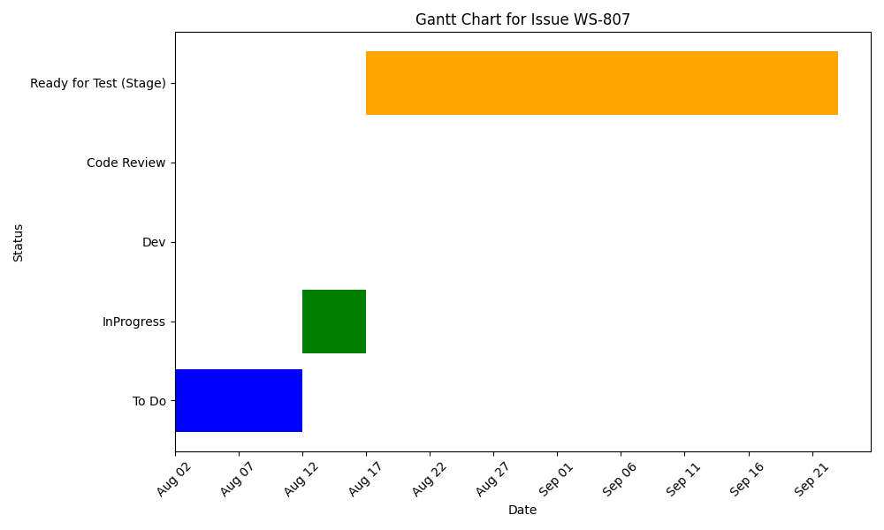

Slide 95
Bulk confirm of POs & TRs (Back)
Assignee/Contributors: Mahnaz Shabihi
Stakeholder:
Deadline: August 21
KRs:
Accomplishments
Challenges
Bulk confirm purchase order and transfer request
Start: August 20
Status: Resolved
Progress: OnTrack
Estimate: 12.0 Hours
Scope Chg:

Slide 96
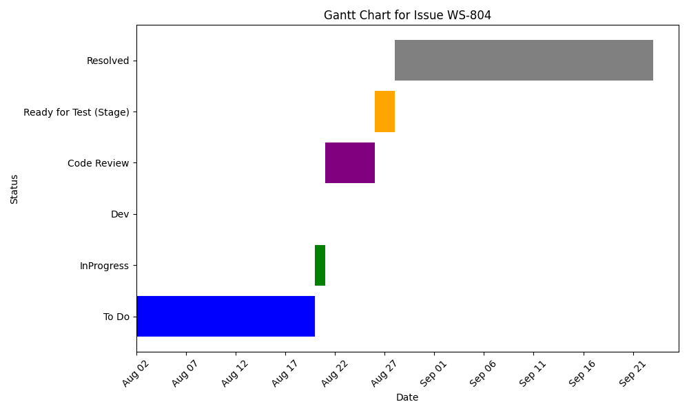

Slide 97
Fix the issue of sales Price Discrepancy in Partial receiving
Assignee/Contributors: Mahnaz Shabihi
Stakeholder:
Deadline:
KRs:
Accomplishments
Challenges
Start: August 19
Status: QA
Progress: OnTrack
Estimate: 12.0 Hours
Scope Chg:

Slide 98
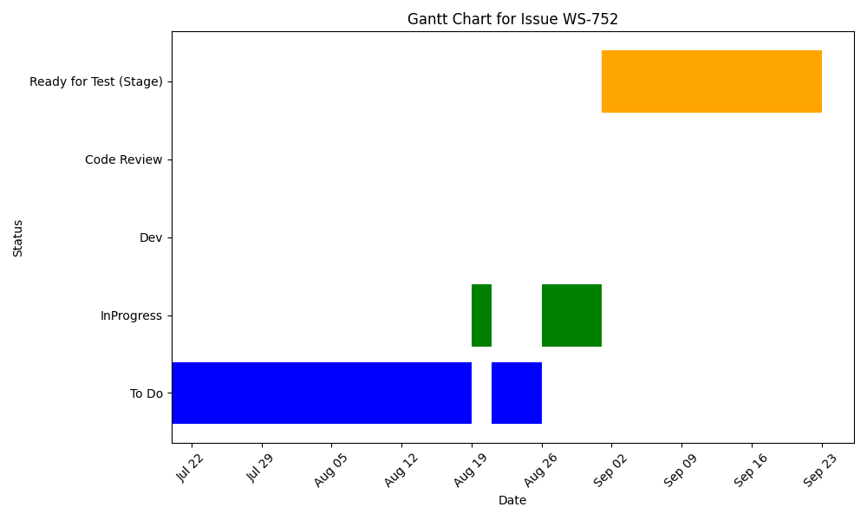

Slide 99
Access per vendor
Assignee/Contributors: Mahnaz Shabihi
Stakeholder: Operation
Deadline:
KRs: Launch of Mart in all of Smart Vendor
Accomplishments
Challenges
Start: July 21
Status: QA
Progress: OnTrack
Estimate: 24.0 Hours
Scope Chg:

Slide 100
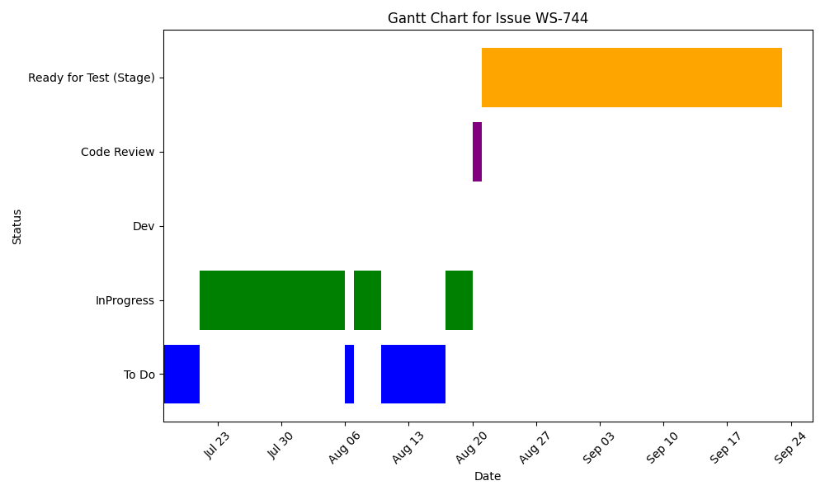

Slide 101
Masoud MohammadHashem

Slide 102
First page: Suppliers' List(App)
Assignee/Contributors: Masoud MohammadHashem
Stakeholder:
Deadline:
KRs:
Accomplishments
Challenges
Start: September 22
Status: InProgress
Progress: OnTrack
Estimate: 12.0 Hours
Scope Chg:

Slide 103
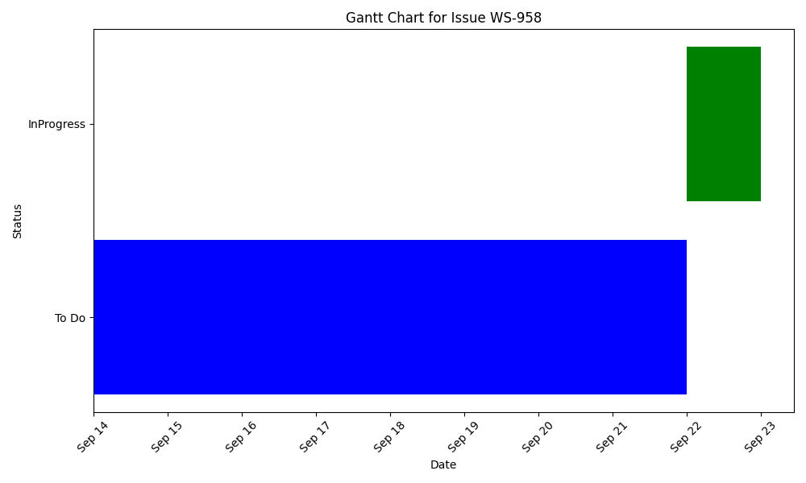

Slide 104
Add Barcode Scan Search to Picked Items Tab
Assignee/Contributors: Masoud MohammadHashem
Stakeholder: Operation
Deadline:
KRs: Launch of Mart in all of Smart Vendor
Accomplishments
Challenges
Start: September 17
Status: Dev
Progress: OnTrack
Estimate: 4.0 Hours
Scope Chg:

Slide 105
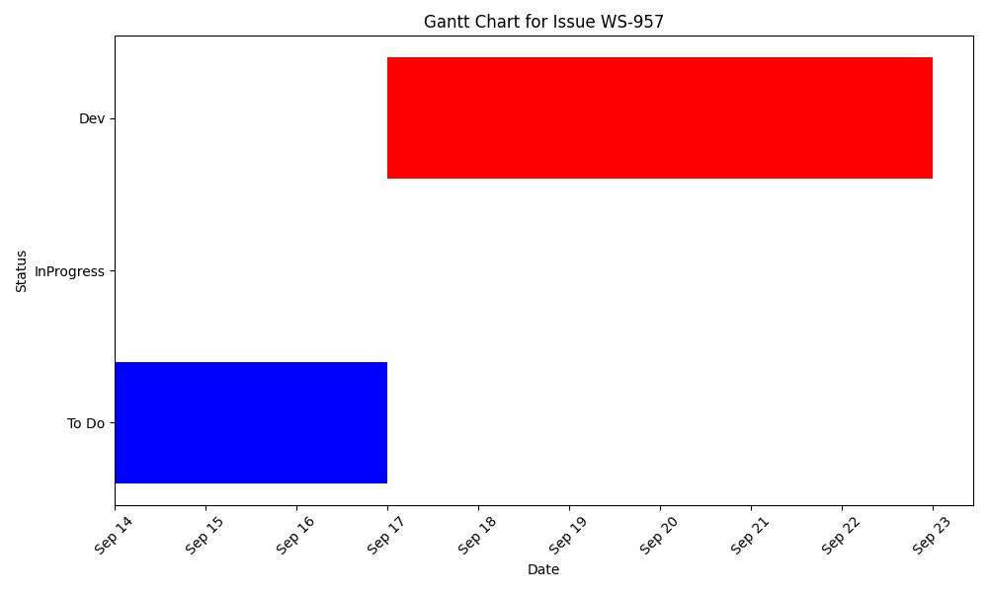

Slide 106
Mart search APP(App)
Assignee/Contributors: Masoud MohammadHashem
Stakeholder:
Deadline:
KRs:
Accomplishments
Challenges
Start: September 9
Status: Dev
Progress: OnTrack
Estimate: 6.0 Hours
Scope Chg:

Slide 107
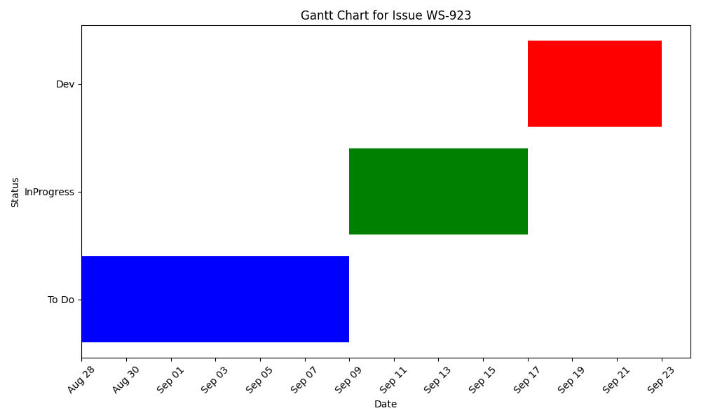

Slide 108
Do not show done picking till picklist is scrolled to the end of the list
Assignee/Contributors: Masoud MohammadHashem
Stakeholder: Operation
Deadline: August 24
KRs: Reduce Purchase Order Processing Time by Suppliers' Panel
Accomplishments
Challenges
Start: September 15
Status: Dev
Progress: OnTrack
Estimate: 3.0 Hours
Scope Chg:

Slide 109
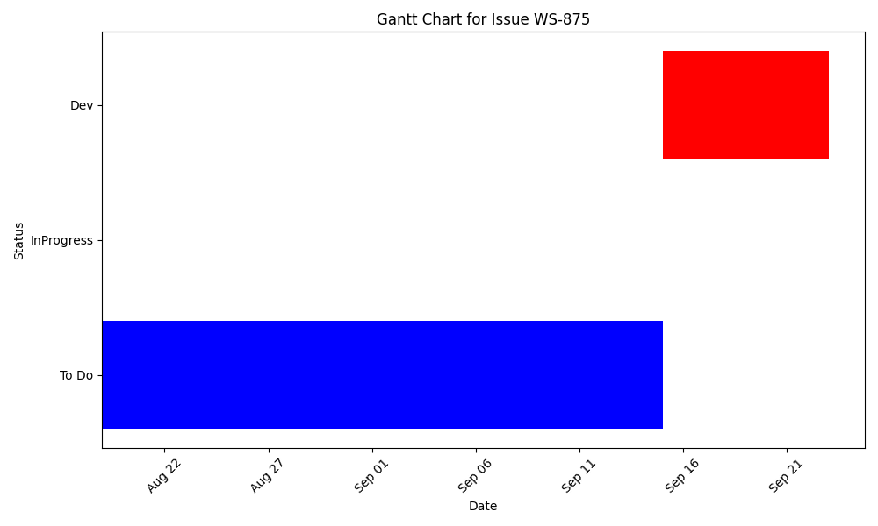

Slide 110
Implement the V2 API(APP)
Assignee/Contributors: Masoud MohammadHashem
Stakeholder: Operation
Deadline:
KRs: Launch of Mart in all of Smart Vendor
Accomplishments
Challenges
Start: August 13
Status: Dev
Progress: OnTrack
Estimate: 3.0 Hours
Scope Chg:

Slide 111
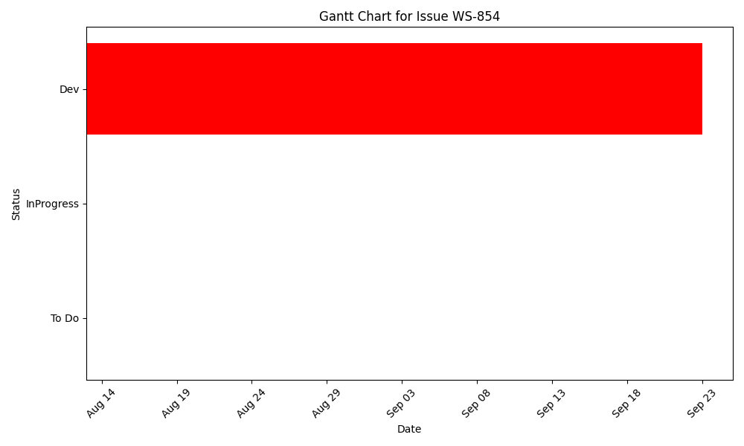

Slide 112
Add validations of scanning item's barcodes or aisle's barcodes
Assignee/Contributors: Masoud MohammadHashem
Stakeholder: Operation
Deadline:
KRs: Launch of Mart in all of Smart Vendor
Accomplishments
Challenges
Start: August 18
Status: Code Review
Progress: OnTrack
Estimate: 6.0 Hours
Scope Chg:

Slide 113


Slide 114
Mart search APP
Assignee/Contributors: Masoud MohammadHashem
Stakeholder:
Deadline:
KRs:
Accomplishments
Challenges
Start: September 17
Status: Dev
Progress: OnTrack
Estimate: 20.0 Hours
Scope Chg:

Slide 115


Slide 116
Mohammad Yaldayi

Slide 117
Display the QC reason's list(App)
Assignee/Contributors: Mohammad Yaldayi
Stakeholder:
Deadline:
KRs:
Accomplishments
Challenges
Start: September 22
Status: InProgress
Progress: OnTrack
Estimate: 9.0 Hours
Scope Chg:

Slide 118


Slide 119
Fix the issue of force update(app)
Assignee/Contributors: Mohammad Yaldayi
Stakeholder:
Deadline:
KRs:
Accomplishments
Challenges
Start: August 7
Status: QA
Progress: OnTrack
Estimate:
Scope Chg:

Slide 120


Slide 121
Fix the search result issue after deleting scanned reference ID
Assignee/Contributors: Mohammad Yaldayi
Stakeholder:
Deadline:
KRs:
Accomplishments
Challenges
Start: August 17
Status: Resolved
Progress: OnTrack
Estimate: 3.0 Hours
Scope Chg:

Slide 122


Slide 123
Unassigned

Slide 124
Display the QC reason's list
Assignee/Contributors: Unassigned
Stakeholder: Operation
Deadline: September 9
KRs: Launch of Mart in all of Smart Vendor
Accomplishments
Challenges
Qc supervisor must choose a reason for bulk items which has picked partially
Start: September 8
Status: InProgress
Progress: OnTrack
Estimate: 9.0 Hours
Scope Chg:

Slide 125


